Slide 1
Mojor Project Presentotion
2025
Emotion Detection Using Text
Anolysis
Exploring Human Emotions Through Text
Dushyont Sehgol, Abdul Samod, Ayush Singh

Slide 2
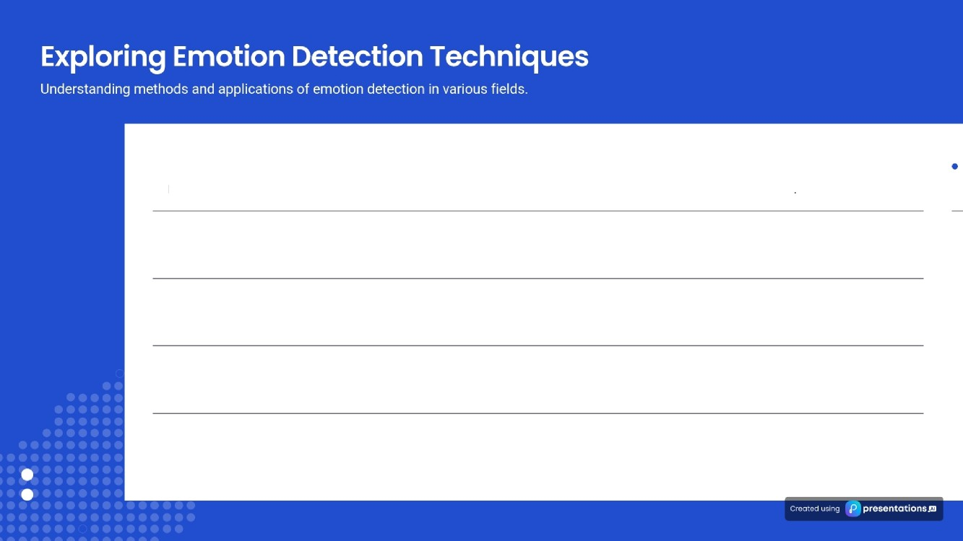
What is Emotion Detection?
Emotion detection refers to identifying human emotions from textual data using various algorithms and methodologies
Applications of Emotion Detection
Key applications include customer support automation, mental health monitoring, and social media analysis to enhance user experiences.
Importance in Customer Support
In customer support, emotion detection stream lines responses, enhances user satisfaction, and improves service efficiency.
Mental Health Insights
Emotion detection provides significant insights into mental health, facilitating timely interventions and support for individuals.

Slide 3
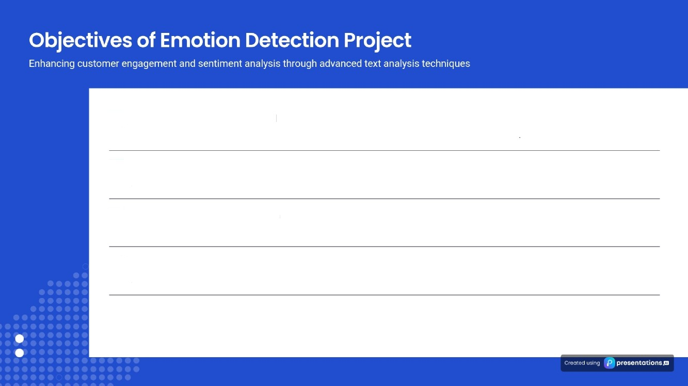
Build a robust emotion model
Develop a strong model for emotion classification from text data to accurately identify user sentiments
Evaluate text analysis techniques
Assess the effectiveness of various text analysis techniques to enhance the accuracy of our emotion detection system.
Deploy for real-time detection
Implement the model for real-time emotion detection in social media posts, facilitating immediate insights.
Improve customer engagement
Aim for improved customer engagement through better understanding of user emotions and sentiments in communications.

Slide 4

Emotion detection in Customer Service
Streamlining responses based on customer emotions enhances the overall service experience.
Importance in Healthcare
Monitoring patient sentiments allows for better care and improved patient outcomes
Tailored Marketing Campaigns
Using audience emotions to tailor campaigns increases engagement and effectiveness.

Slide 5
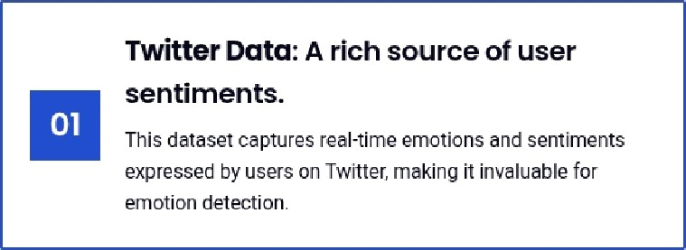
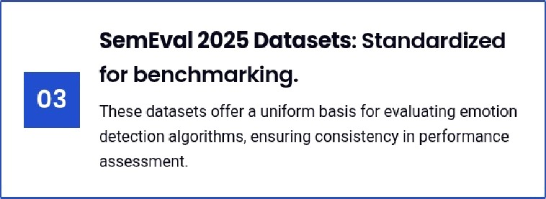
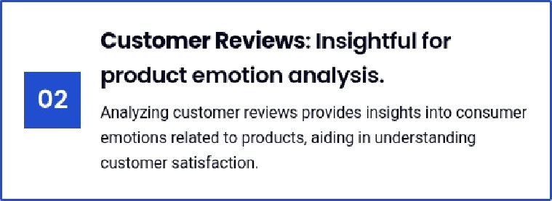
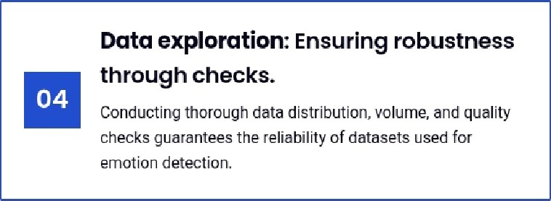

Understanding Doto for Emotion Detection in Text Anolysis
ExploriiJg various datasets and their roles in emotion detection through text analysis
Twitter Data: A rich source of user
sentiments.
This dataset captures real-time emotions and sentiments expressed by users on +witler, making it invaluable for
SemEvol 2025 Dotosets: Standardized
for benchmarking.
These datasets offer a uniform basis for evaluating emotion detection algorithms, ensuri ng consi stency in performance
Customer Reviews: Insightful for product emotion analysis.
Analyzing customer reviews provides insights into consumer emotions related to Droducts, aiding in understanding
Data exploration: Ensuring robustness
Conducting thorough oata distr but on, volume, and quality
eiotondeiecnon.
Utilized dotosets for emotion detection.
We leverage three major datasets: Twitter Data, Customer Reviews, and SemEval 2025 far comprehensive analysis.
3 dotosets
100% data quality
checks
Ensured robustness through quality checks.
All datasets undergo rigorous quality checks to maintain a standard for emotion detection algorithms.
^œn'ea 1°nç preseutotions

Slide 6
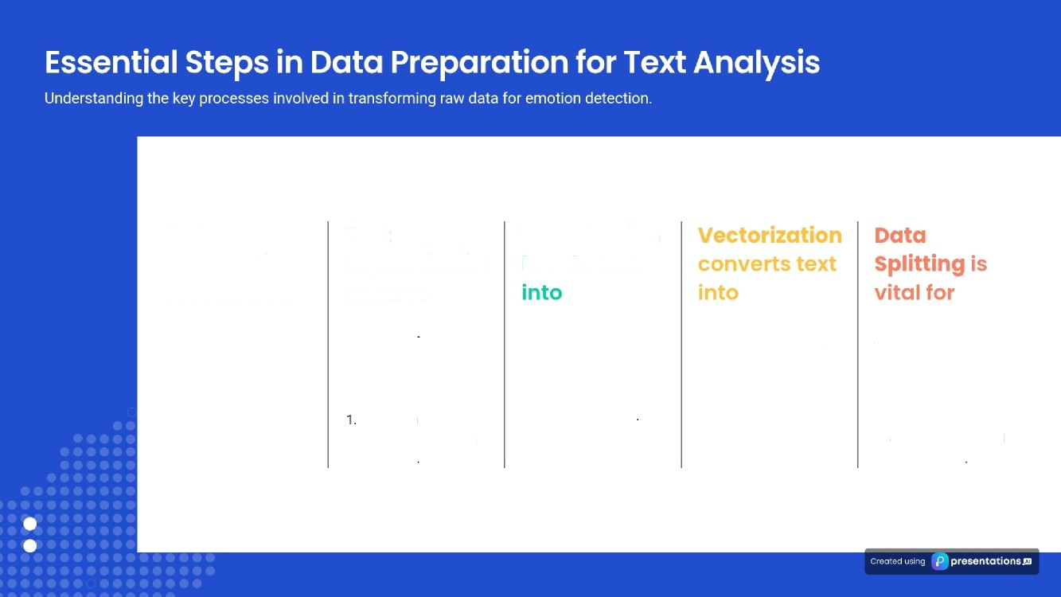
Text Normcllizntioi ensures
Data Preparation is crucial for
Transforms row data into usable formats.
1. Sets the foundation
for accurate results.
Tokenizotion brea ks text
Lowercosing removes case sensitivity.
Removing punctuation helps in clean text
Splits text into
individual words.
1. Facilitates further processing steps
Uses techniques like TF-IDF or word embeddings.
1. Enables machine learning algorithms to process text.
Creates training, validation, and test datasets.
1. Ensures unbiased evaluation of model performance

Slide 7



Exploring Modeling Techniques for Emotion
Detection
An overview of traditional, deep learning, and hybrid approaches in emotion detection.
Traditional Machine Learning methods like SVM and Random Forests.
These techniques utilize statistical apDroaches to classify emotions Dased on feature extraction.
Hybrid Approaches that combine traditional and deep learning.
These strategies aim to leverage the benefits of both methodologies for improved accuracy.
Deep Learning Models such as LSTM and BERT.
These models leverage neural networks for context-aware understanding of textual data.
Performance evaluation based on accuracy and FI-score metrics.
Each technique's effectiveness is assessed, ensuring the best model is selected for practical applications.
Accuracy achieved by LSTM models.
LSTM models have shown a remarkable ability to accurately detect emotions in text.
90%
F1-score of hybrid models.
This score indicates a strong balance between precision and recall in emotion detection.
0.85

Slide 8

Performance Metrics
Utilization of metrics such as Precision, Recall, F1-score, and Accuracy to quantify model effectiveness
Cross-Validation
Implementing cross-validation techniques to ensure model reliability across multiple datasets and prevent overfitting
Comparison Against Benchmarks
Analyzing results in relation to benchmark models established during SemEval 2025 for a comprehensive comparison
Identifying Effective Models
This thorough evaluation process helps in identifying the most effective model suitable for deployment in real-world applications.

Slide 9
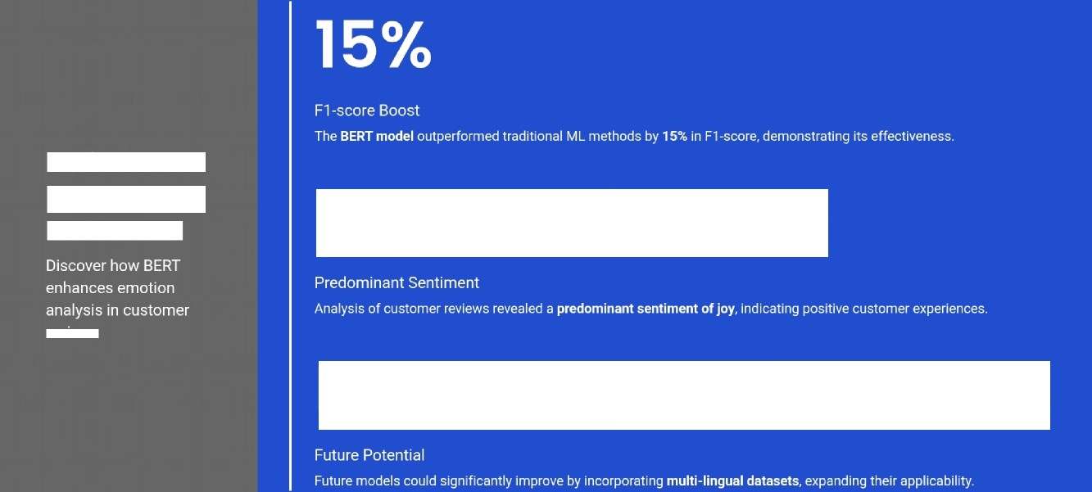
Joy Dominonce
Performance
Insights from
BERT Model
reviews
Multi-lïnguol Dotosets
ea
g
proseutotionsœ

Slide 10
Web Application for Emotion Detection
An interface designed for users to input text and receive real-time feedback on detected emotions, enhancing engagement and user experience.
API Integration for Businesses
Providing businesses the capability to seamlessly integrate emotion
service offerings.
Establishing a system for continual updates to the emotion detection model, ensuring it evolves based on user feedback and new data inputs for improved accuracy
Monitoring and Feedback Loop

Slide 11

Advancements in Emotion Detection
Exploring future enhancements in emotion detection technology and applications
Cross-linguol Models
Emending capabilities to support multiple languages, enhancing global accessibility.
Real-time Adaptation
Models that learn and adapt in real-time from new data, improving their accuracy and responsiveness
Broader Emotion Spectrum
Detecting a wider range of emotions beyond the basics, allowing for more nuanced
understanding.

Slide 12

Project Overview and Results
This project on emotion detection using text analysis has yielded promising outcomes, showcasing effective methodologies
Advanced Modeling Techniques
Utilizing advanced modeling techniques has significantly enhanced our ability to interpret user sentiments and emotions.
Cross-Industry Applications
The findings from this project can be applied across various industries, enabling more emotionally aware technology solutions.
Future Implications
These promising results pave the way for future developments in technology that prioritize emotional understanding in user interactions

Slide 13
THANK YOU!
ea
g
proseutotionsœ

